Slide 1




Best of SELSE - DSN 2020, May 2020
Thermal Neutrons: a Possible Threat for Supercomputers and Safety Critical Applications
Daniel Oliveira, Sean Blanchard, Nathan DeBardeleben, Fernando Santos, Gabriel Piscoya, Philippe Navaux, Stephen Wender, Carlo Cazzaniga, Christopher Frost, Robert Baumann, Paolo Rech
Notes:
1
1

Slide 2

Sponsors
Rosen Scholar 2019 fellowship
LDRD projects 20190499ER - 20180017ER
Beam time at ChipIR and ROTAX
Research Grants
GPU grants
2

Slide 3
Thermal Neutrons: a Known Problem
Thermal neutrons: <0.5 eV
Produced by the moderation of high energy neutrons
⁴He
If Boron-10 is present thermal neutrons can generate faults in computing devices*.
^{Thermal neutron}
^{Boron 10}
⁷Li
*Baumann TNS’00 Dirk TNS’03
3

Slide 4
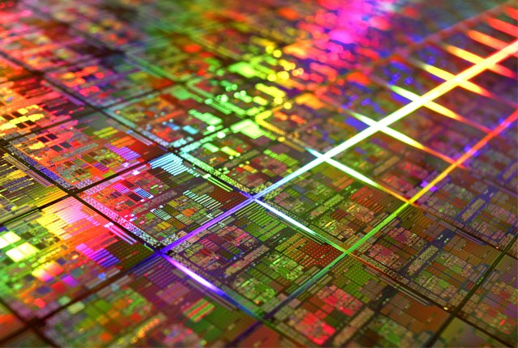
Thermal Neutrons: a Known Problem
Thermal neutrons: <0.5 eV
Produced by the moderation of high energy neutrons
⁴He
If Boron-10 is present thermal neutrons can generate faults in computing devices*.
^{Thermal neutron}
^{Boron 10}
⁷Li
*Baumann TNS’00 Dirk TNS’03
Boron is necessary for the manufacturing process. As purifying Boron is expensive,
COTS devices might contain ¹⁰B.
3

Slide 5


Motivation
Cloud
Consumer
HPC
Data Center
automotive
Good
High
Very High
Reliability Requirements (*Arijit Biswas, SELSE 2018)
4

Slide 6
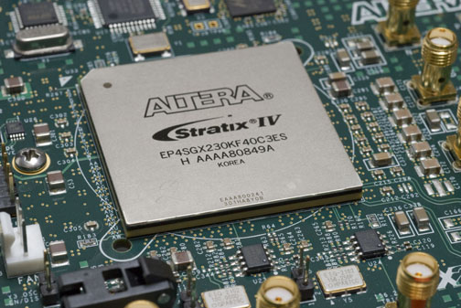
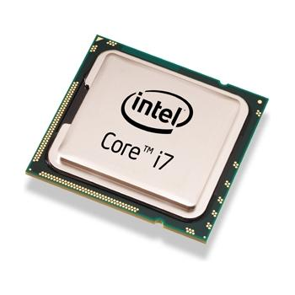
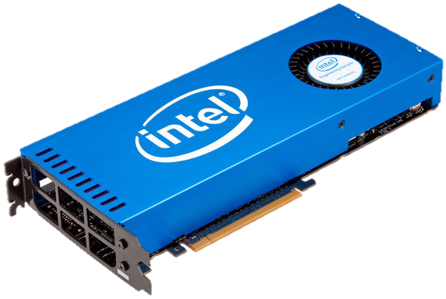
Motivation
ARM
CPU
co-processor
GPU
FPGA/SoC
Cloud
Consumer
HPC
Data Center
automotive
Good
High
Very High
Reliability Requirements (*Arijit Biswas, SELSE 2018)
4

Slide 7
Motivation
ARM
CPU
co-processor
GPU
FPGA/SoC
Cloud
Consumer
HPC
Data Center
automotive
Good
High
Very High
Reliability Requirements (*Arijit Biswas, SELSE 2018)
4

Slide 8
Motivation
ARM
CPU
co-processor
GPU
FPGA/SoC
We can’t assume that COTS devices are immune to thermal neutrons
Cloud
Consumer
HPC
Data Center
automotive
Good
High
Very High
Reliability Requirements (*Arijit Biswas, SELSE 2018)
4

Slide 9
Motivation
ARM
CPU
co-processor
GPU
FPGA/SoC
We can’t assume that COTS devices are immune to thermal neutrons
- Are COTS devices sensitive to thermal neutrons?
- Should we consider thermals contribution to the device’s error rate?
- How does the environment impact the thermal-induced FIT rate?
Cloud
Consumer
HPC
Data Center
automotive
Good
High
Very High
Reliability Requirements (*Arijit Biswas, SELSE 2018)
4

Slide 10
Outline
Background
Beamlines: ChipIR and ROTAX
Computing Devices and Configurations
Thermal Neutrons Sensitivity of COTS Devices
Thermal Flux and Devices FIT rates
Conclusions and Future Work
5
Notes:
10

Slide 11
Outline
Background
Beamlines: ChipIR and ROTAX
Computing Devices and Configurations
Thermal Neutrons Sensitivity of COTS Devices
Thermal Flux and Devices FIT rates
Conclusions and Future Work
Notes:
11

Slide 12
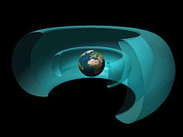
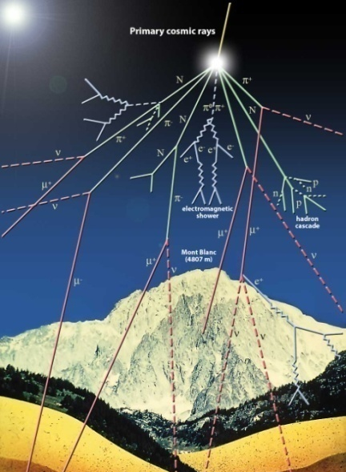
Terrestrial Radiation Environment
Cosmic rays could be so energetic
to pass the Van Allen belts
Cosmic Ray
Galactic cosmic rays interact with atmosphere
shower of energetic particles:
Muons, Pions, Protons, Gamma rays, Neutrons
6

Slide 13
Terrestrial Radiation Environment
Cosmic rays could be so energetic
to pass the Van Allen belts
Cosmic Ray
Galactic cosmic rays interact with atmosphere
shower of energetic particles:
Muons, Pions, Protons, Gamma rays, Neutrons
High energy flux: 13 n/(cm² / h) @sea level*
*JEDEC JESD89A Standard
6

Slide 14
Thermal Neutrons Flux
high energy
high energy
7

Slide 15
Thermal Neutrons Flux
high energy
high energy
thermals
thermals
7

Slide 16
Thermal Neutrons Flux
high energy
high energy
product of reaction
thermals
thermals
7

Slide 17
Thermal Neutrons Flux
thermals
thermals
7

Slide 18
Thermal Neutrons Flux
high energy
high energy
⁴He
thermals
^{Boron 10}
thermals
⁷Li
7

Slide 19
Thermal Neutrons Flux
Thermal neutron sensitivity depends on the device manufacturing process (how much ¹⁰B?)
high energy
high energy
⁴He
thermals
^{Boron 10}
thermals
⁷Li
7

Slide 20
Thermal Neutrons Flux
Thermal neutron sensitivity depends on the device manufacturing process (how much ¹⁰B?)
high energy
high energy
Thermal neutron flux strongly depends on the environmental conditions (how many thermal neutrons?)
⁴He
thermals
^{Boron 10}
thermals
⁷Li
7

Slide 21
Outline
Background
Beamlines: ChipIR and ROTAX
Computing Devices and Configurations
Thermal Neutrons Sensitivity of COTS Devices
Thermal Flux and Devices FIT rates
Conclusions and Future Work
Notes:
21

Slide 22
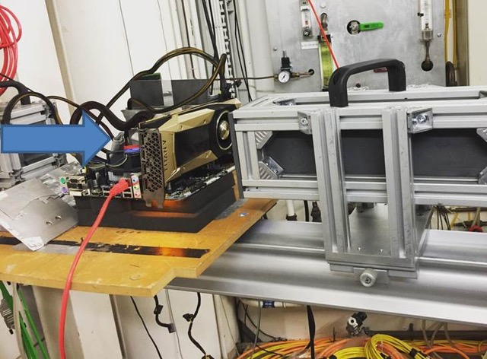
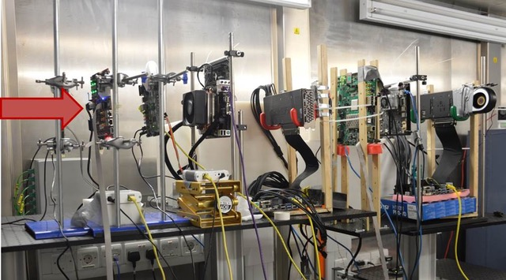
ChipIR and ROTAX (RAL, UK)
ROTAX
ChipIR
Identical setups
-Same DUT
-Same code
-Same input
-Same support HW
Flux ~2x10⁵ n/cm²/s
One board
(Titan V in the pic)
Flux ~5x10⁶ n/cm²/s
Multiple boards
8

Slide 23
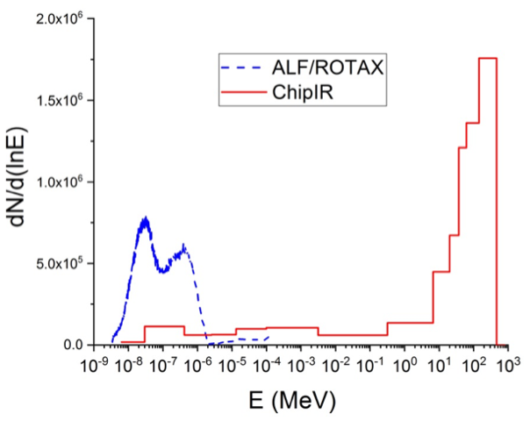
ChipIR and ROTAX (RAL, UK)
ROTAX
ChipIR
Identical setups
-Same DUT
-Same code
-Same input
-Same support HW
Flux ~2x10⁵ n/cm²/s
One board
(Titan V in the pic)
Flux ~5x10⁶ n/cm²/s
Multiple boards
9

Slide 24
ChipIR and ROTAX (RAL, UK)
ROTAX
ChipIR
Identical setups
-Same DUT
-Same code
-Same input
-Same support HW
Flux ~2x10⁵ n/cm²/s
One board
(Titan V in the pic)
Flux ~5x10⁶ n/cm²/s
Multiple boards
Most neutrons at ROTAX are thermals
Most neutrons at ChipIR have high energy
10

Slide 25
Outline
Background
Beamlines: ChipIR and ROTAX
Computing Devices and Configurations
Thermal Neutrons Sensitivity of COTS Devices
Thermal Flux and Devices FIT rates
Conclusions and Future Work
Notes:
25

Slide 26
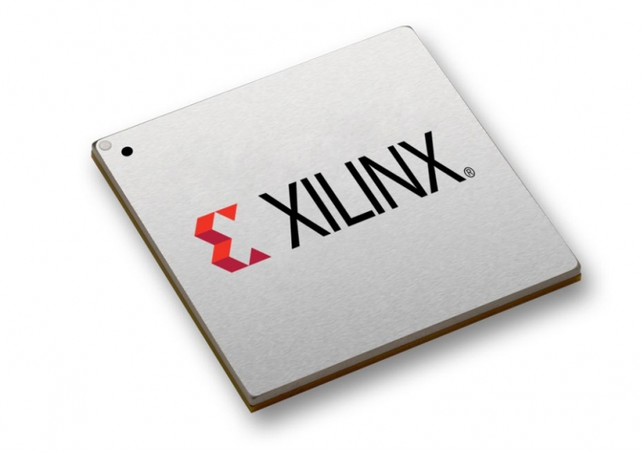
Tested Devices and Configurations
Xilinx FPGA
28nm, planar CMOS
TSMC
Intel Xeon Phi
22nm, Tri-gate
3x NVIDIA GPUs
K20: 28nm, planar CMOS
Titan X-V: 16nm, FinFET
AMD APU (CPU+GPU)
28nm, planar CMOS
Global Foundries
11

Slide 27
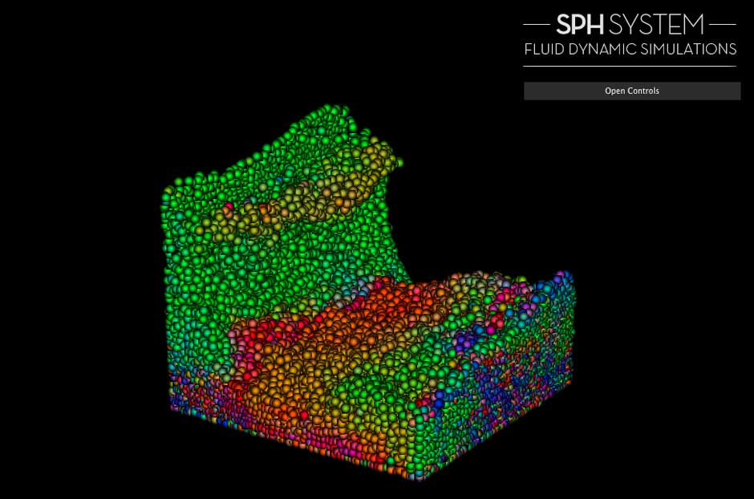
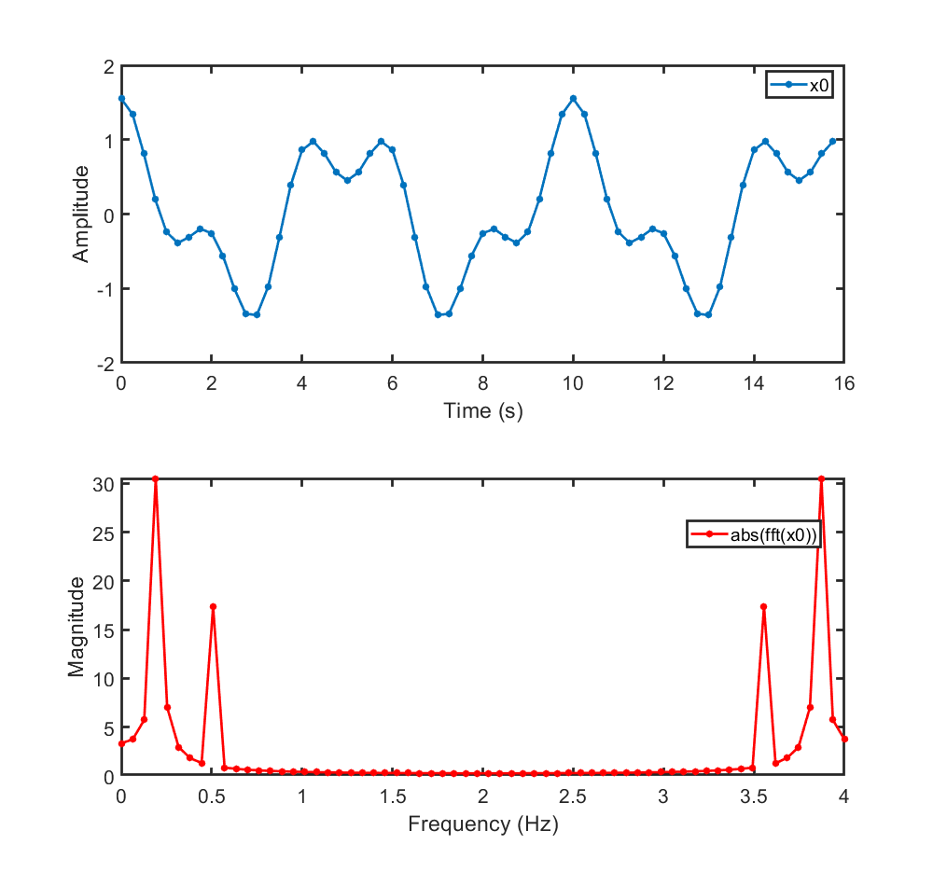
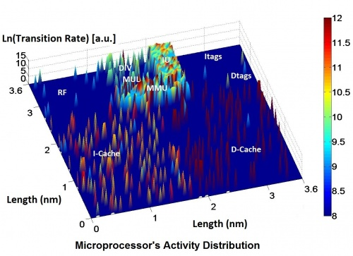
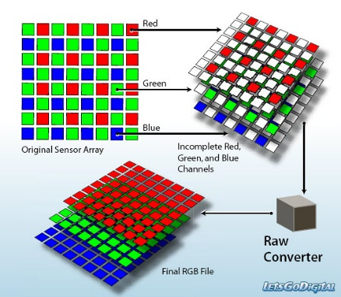
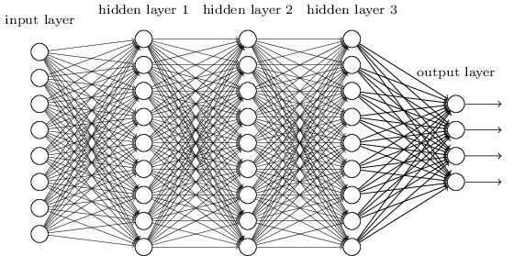
Tested Devices and Configurations
Xilinx FPGA
28nm, planar CMOS
TSMC
Intel Xeon Phi
22nm, Tri-gate
3x NVIDIA GPUs
K20: 28nm, planar CMOS
Titan X-V: 16nm, FinFET
AMD APU (CPU+GPU)
28nm, planar CMOS
Global Foundries
11

Slide 28
Outline
Background
Beamlines: ChipIR and ROTAX
Computing Devices and Configurations
Thermal Neutrons Sensitivity of COTS Devices
Thermal Flux and Devices FIT rates
Conclusions and Future Work
Notes:
28

Slide 29
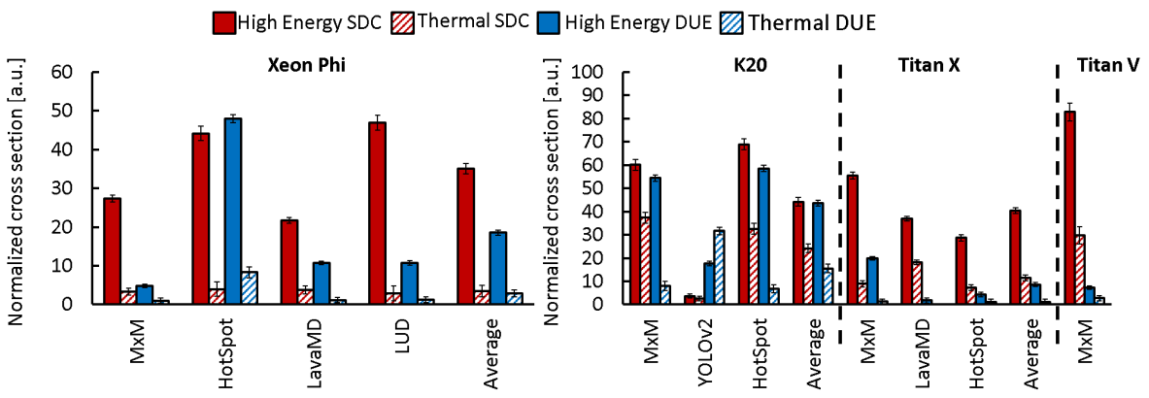
Thermal vs High Energy Neutrons Cross Section
12

Slide 30
Thermal vs High Energy Neutrons Cross Section
All devices are sensitive to thermals.*
𝜎 _{high energy} vs 𝜎 _{thermals} depends on device
*more devices in the paper
12

Slide 31
Thermal vs High Energy Neutrons Cross Section
Xeon Phi (average)
𝜎 _{high energy} = 10x 𝜎 _{thermals}
13

Slide 32
Thermal vs High Energy Neutrons Cross Section
Xeon Phi (average)
𝜎 _{high energy} = 10x 𝜎 _{thermals}
GPUs (average)
𝜎 _{high energy} = 2.5x 𝜎 _{thermals}
14

Slide 33
Thermal vs High Energy Neutrons Cross Section
𝜎_{high energy vs} 𝜎_{thermals} ratio depends also on the code:
the fault model depends on the neutron energy
Xeon Phi (average)
𝜎 _{high energy} = 10x 𝜎 _{thermals}
GPUs (average)
𝜎 _{high energy} = 2.5x 𝜎 _{thermals}
15

Slide 34
Outline
Background
Beamlines: ChipIR and ROTAX
Computing Devices and Configurations
Thermal Neutrons Sensitivity of COTS Devices
Thermal Flux and Devices FIT rates
Conclusions and Future Work
Notes:
34

Slide 35
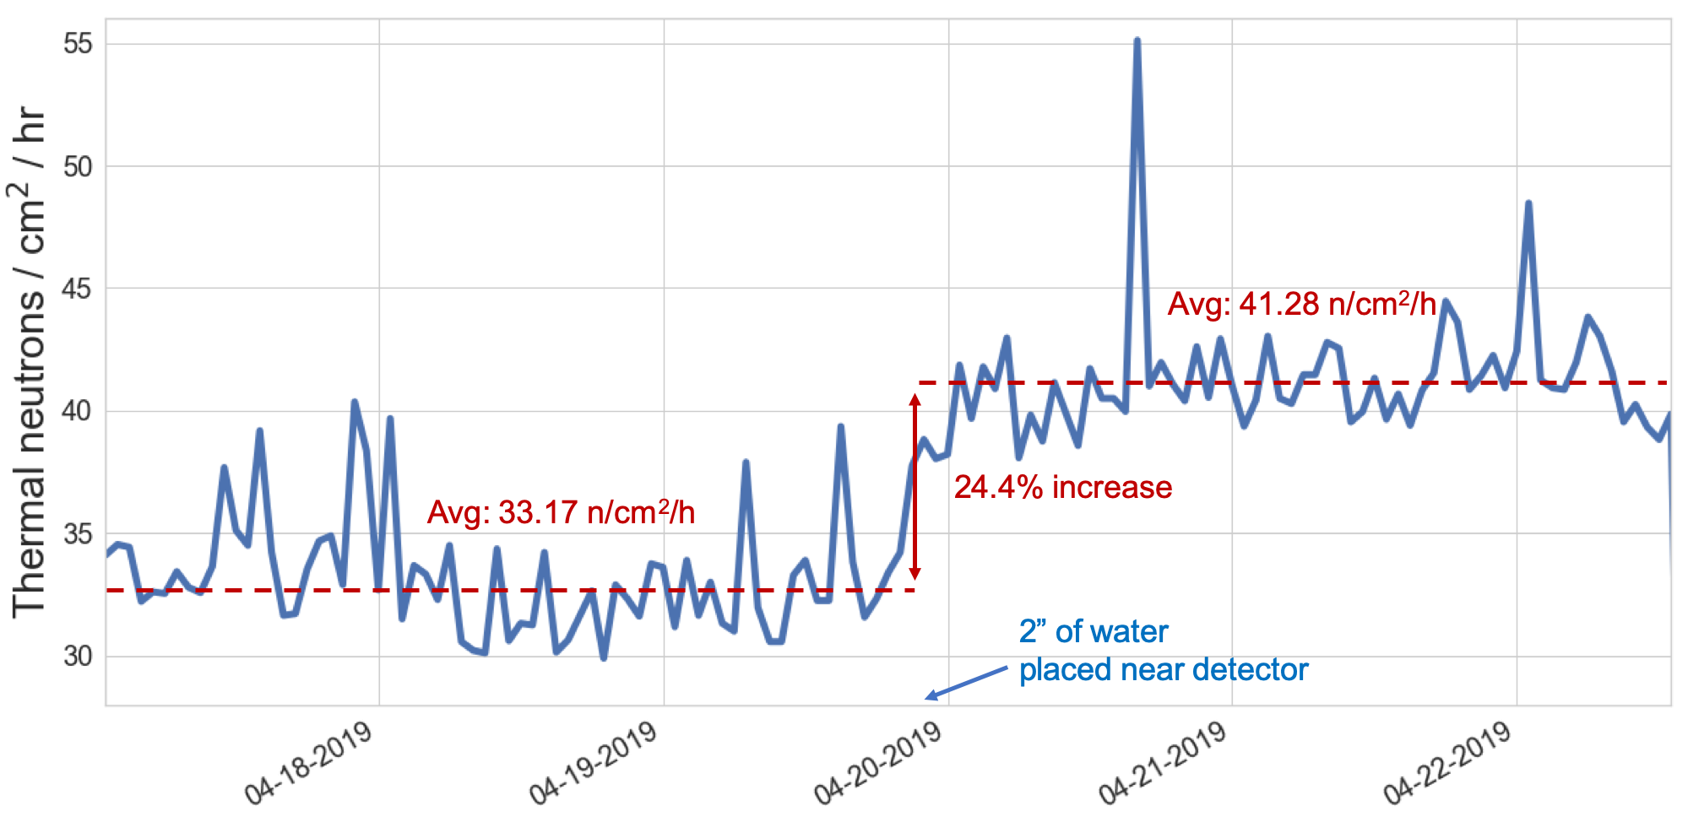
FIT rates (what about the flux?)
Environmental conditions (concrete walls, liquid cooling, fuel) significantly change the flux of thermal and high energy neutrons.
16

Slide 36
FIT rates (what about the flux?)
Environmental conditions (concrete walls, liquid cooling, fuel) significantly change the flux of thermal and high energy neutrons.
16

Slide 37
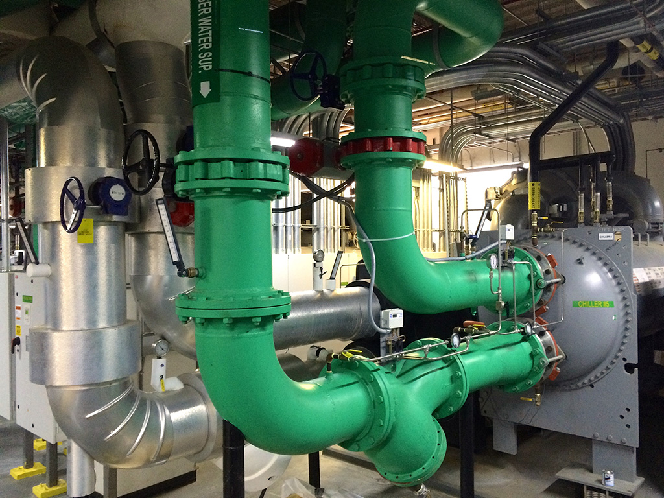
FIT rates (what about the flux?)
Environmental conditions (concrete walls, liquid cooling, fuel) significantly change the flux of thermal and high energy neutrons.
16

Slide 38
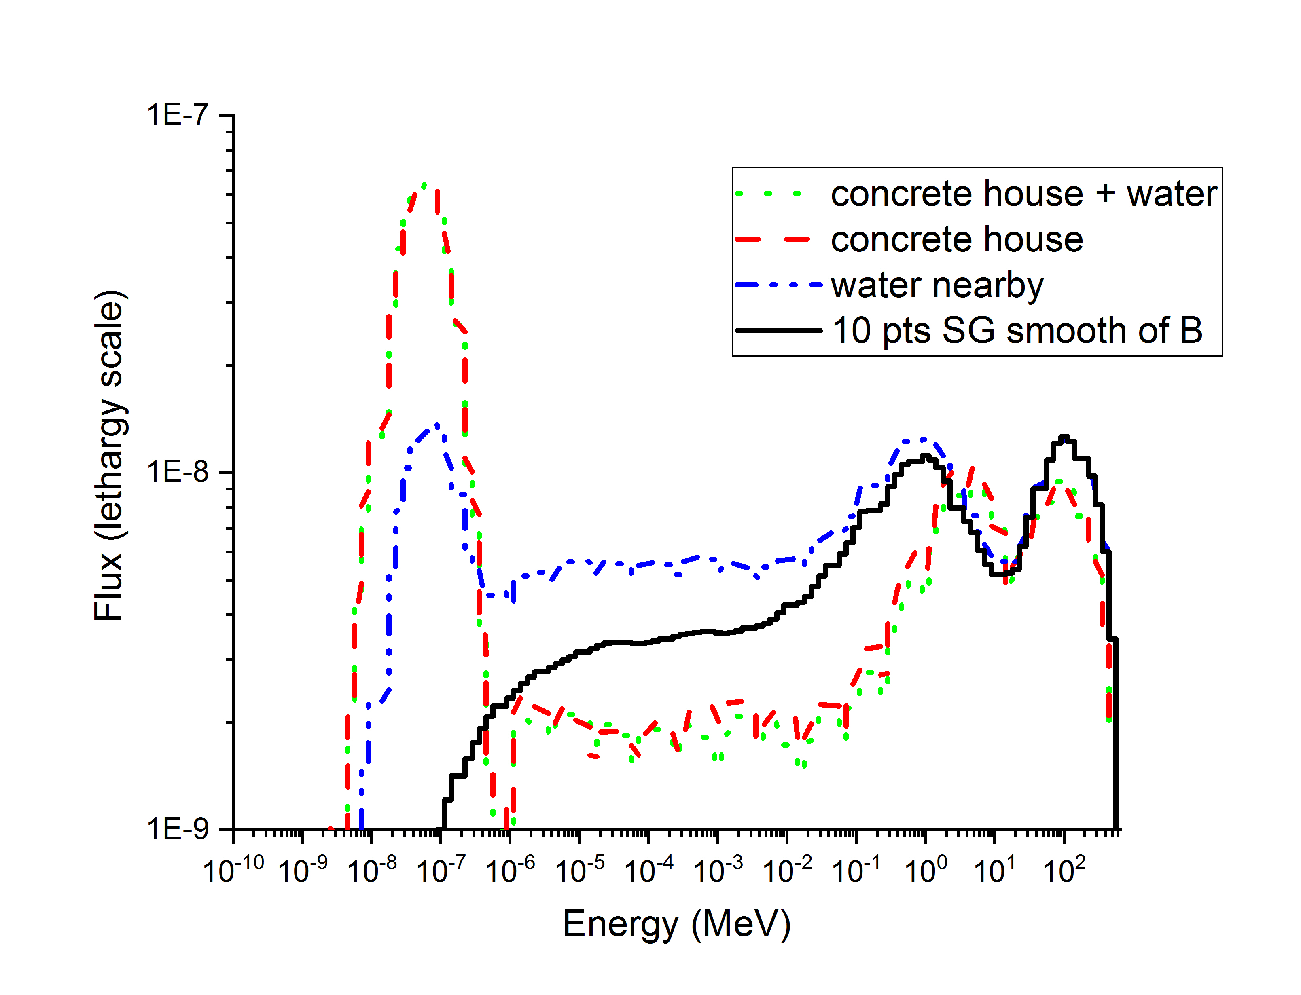
FIT rates (what about the flux?)
Environmental conditions significantly change the flux of thermal and high energy neutrons.
Concrete walls, water (cooling systems), fuel increase the flux of thermals neutrons.
17

Slide 39
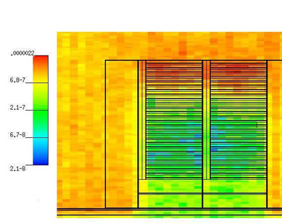
FIT rates (what about the flux?)
Environmental conditions significantly change the flux of thermal and high energy neutrons.
Concrete walls, water (cooling systems), fuel increase the flux of thermals neutrons.
We have modeled and simulated with MCNP the water cooling system of supercomputers.
Thermal neutron flux can be increased up to 40%-80%.
(details in the paper)
17

Slide 40
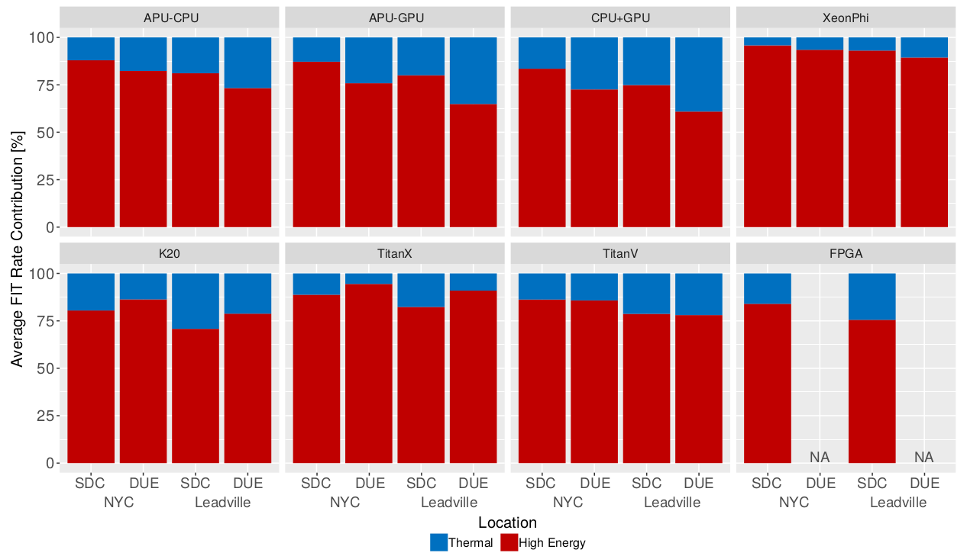
FIT rates (what about the flux?)
How much do thermal neutrons contribute to the device FIT rate?
18

Slide 41
FIT rates (what about the flux?)
How much do thermal neutrons contribute to the device FIT rate?
K20 has 30% SDC FIT
caused by thermals
18

Slide 42
FIT rates (what about the flux?)
How much do thermal neutrons contribute to the device FIT rate?
APU has 40% DUE FIT
caused by thermals
K20 has 30% SDC FIT
caused by thermals
19

Slide 43
Outline
Background
Beamlines: ChipIR and ROTAX
Computing Devices and Configurations
Thermal Neutrons Sensitivity of COTS Devices
Thermal Flux and Devices FIT rates
Conclusions and Future Work
Notes:
43

Slide 44
Conclusions and Future Work
-COTS devices might still include Boron-10 in the manufacturing process
-Thermal neutrons experiments become necessary to evaluate the contribution of thermal neutrons to the device error rate
-There is an application-dependent response to thermal vs high-energy neutrons, which indicates that the fault model depends on neutrons energy
-Thermal neutrons flux (and then devices FIT rates) depends on the environment
-We are simulating the effects of neutrons in transistors layout
20
Notes:
44

